Slide 1
IT 350 MINI PROJECT
Content Similarity Analysis of Written Comments under Posts in Social Media
Team No :- 5
Guide : Dr Anand Kumar
Team Members:
Mohit Awachar 191IT231
Anshul Patel 191IT208
Rakshit Kulkarni 191IT245

Slide 2
Introduction
Written comments to the posts on social media are an important metric to measure the followers’ feedback to the content of the posts.
But the huge presence of unrelated comments following each post can impact many parts of people engagement as well as the visibility of the actual post.
Related comments to a post’ s topic usually provide readers more insight into the post content and can attract their attention.
On the other hand, unrelated comments distract them from the original topic of the post or disturb them by worthless content and can mislead or impact their opinion.

Slide 3
Objectives
To classify the comments into related and unrelated comments for the given post
Feature extraction of the comments based on the different similarity measures
Compare three methods of text similarity cosine, word-to-vec and Indic Bert for comment and post similarity
To analyze social media post and comments based on the model built.

Slide 4
DataSet
We are scraping the data from the BBC News page of the Facebook.
We mainly scrap the caption and comments under the post.
Total Posts = 92
Comments = 3380
Labelled Posts( For related and unrelated comments) = 92
After Filtering and Preprocessing
Total Comments = 3173

Slide 5
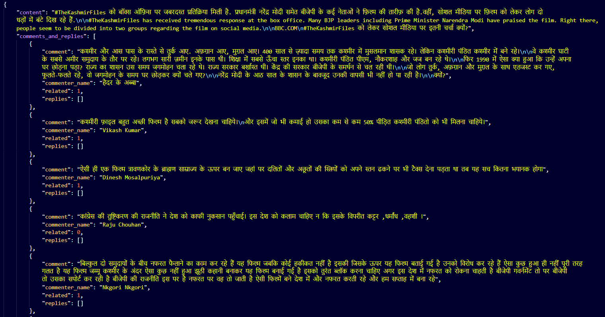

Slide 6
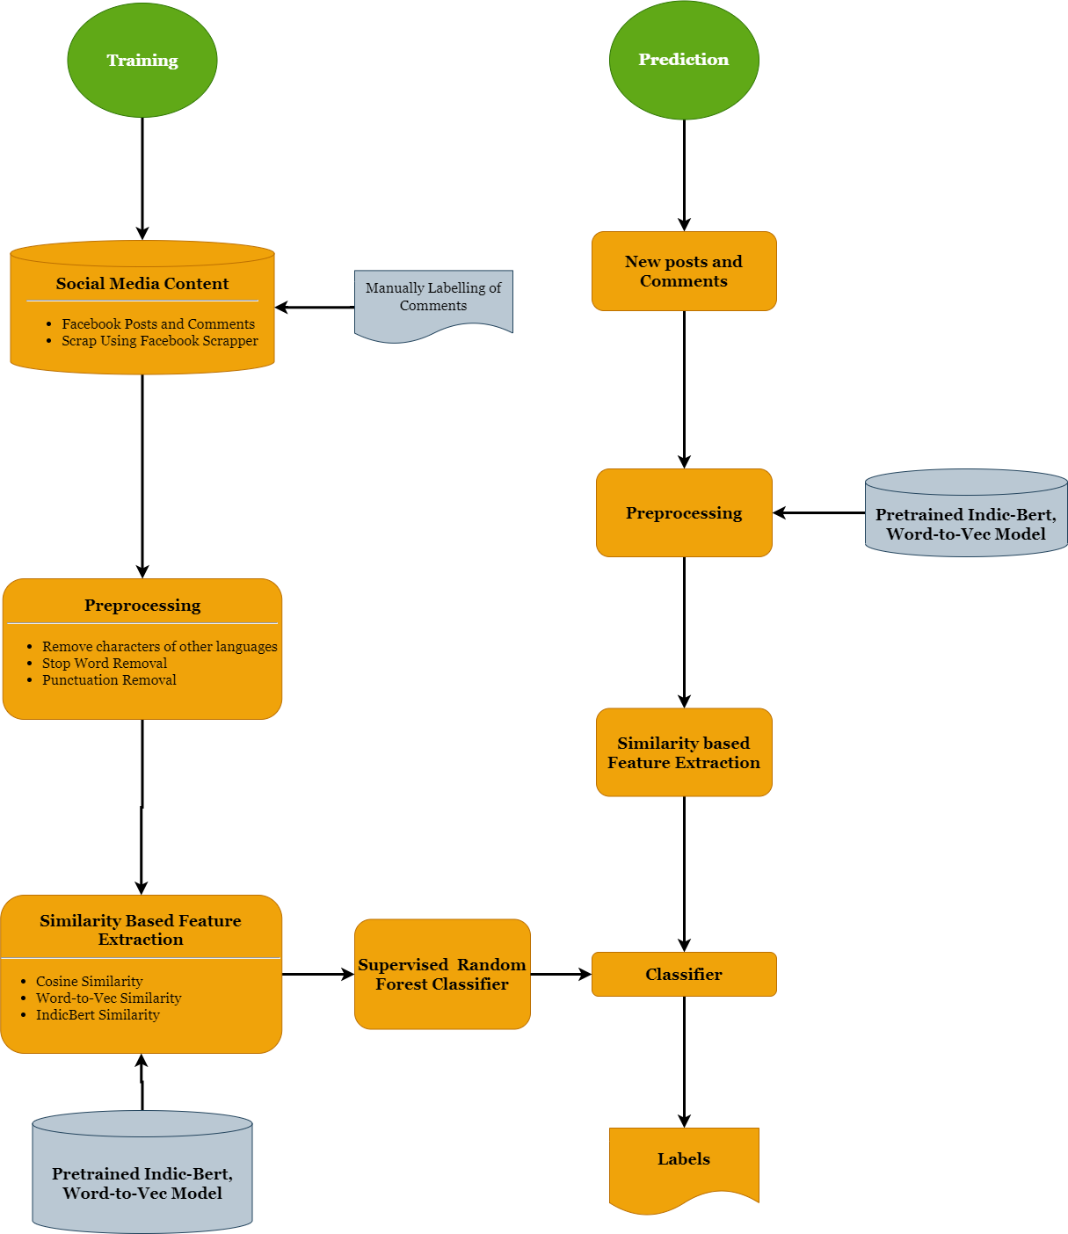
Methodology

Slide 7
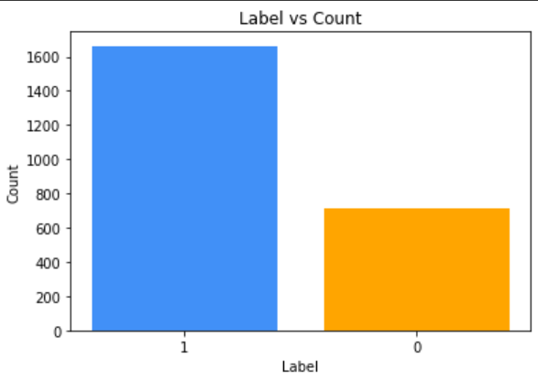
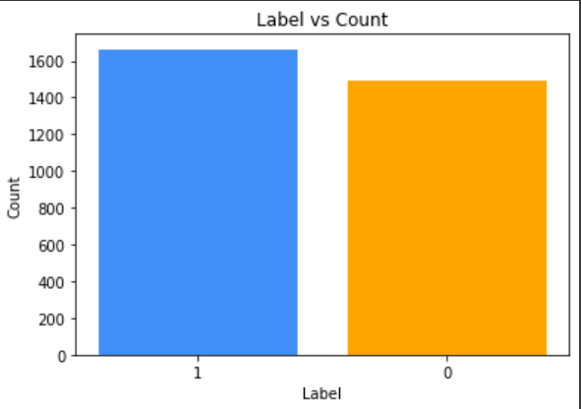
Handling Data Imbalance Using SMOTE

Slide 8
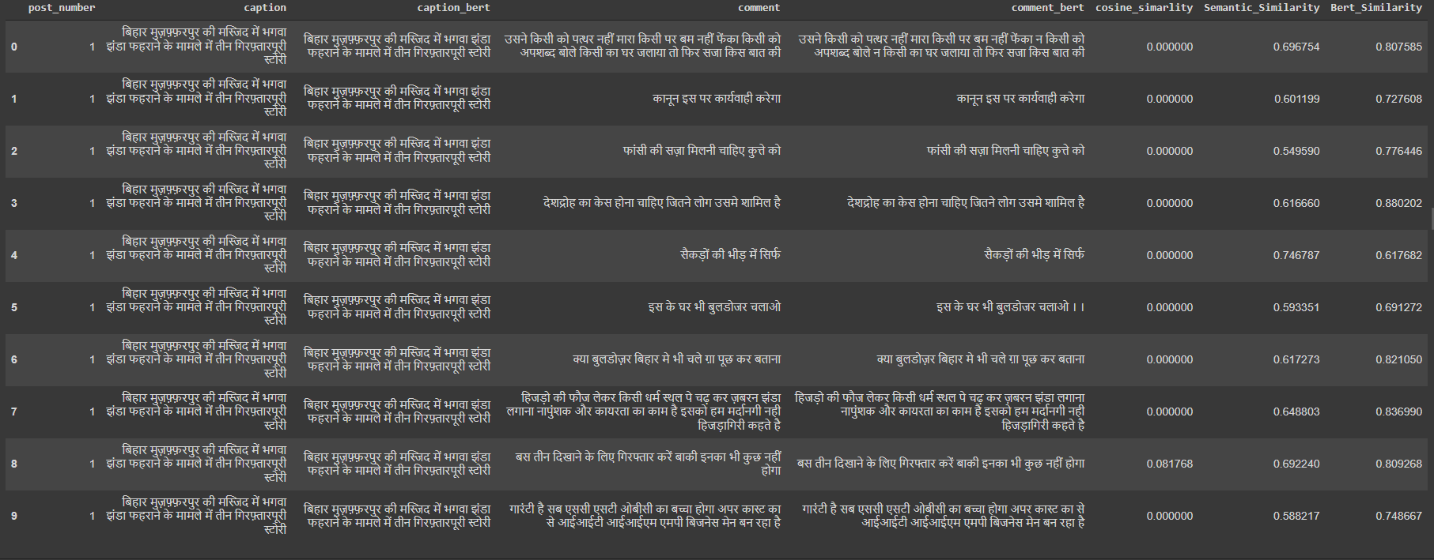
Results :

Slide 9
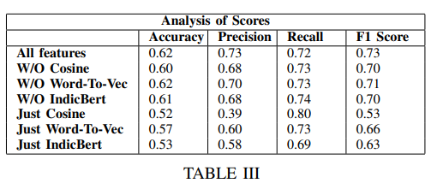
Use Random Forest Classifier to predict the Scores

Slide 10
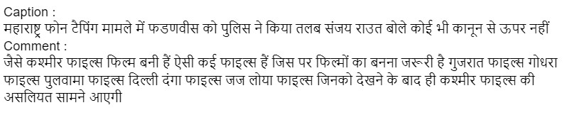
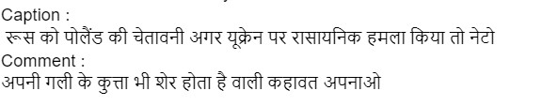
Case Study
We use the trained model to analyze comments and posts on the BBC Hindi news page.
Total Posts Scrapped : 180
Total Comments : 6554
Related : 6248
Unrelated : 306

Slide 11
Novelty
New Dataset is used from Facebook scrapper
The framework is built for a new Language HIndi
Use of IndicBERT similarity which is different from BASE paper

Slide 12
Reference
Base Paper :- Content Similarity Analysis of Written Comments under Posts in Social Media.
M. Mozafari, R. Farahbakhsh and N. Crespi, "Content Similarity Analysis of Written Comments under Posts in Social Media," 2019 Sixth International Conference on Social Networks Analysis, Management and Security (SNAMS), 2019, pp. 158-165, doi: 10.1109/SNAMS.2019.8931726.

Slide 13
Thank You

